Slide 1
Lecture 5/Lecture 6
Outline
5.0 PROCESSOR MANAGEMENT
5.1 Job scheduler
5.2 Process scheduler
5.3 Job control block
5.4 Process control block
5.5 Priorities
5.6 Processor scheduling techniques
5.6.1 Preemptive scheduling techniques
5.6.2 Non-preemptive techniques
6.0. SCHEDULING ALGORITHM
6.1 First-in-First-out (FIFO)
6.2 Round Robin
6.3 Highest Priority First
6.4 Shortest Job First
6.5 Shortest Remaining Time
6.6 Highest Response Ratio Next

Slide 2
Processor Management
This is concerned with the management of processors in the system, thus the allocation of processors to processes.
Functions
1)To keep track of processors and the status of processes. It carries out by Traffic Controller.
2)To decide who will have a chance of using the processor
There are two routines for this; They are
i). Job scheduler and ii). Process Scheduler
-The Job scheduler creates the processes and may choose the process that will have to be assigned the processor in a batch system. It also moves processes from HOLD state to READY state.
-Choosing a process to be assigned to a processor in a multiprogramming system is done by the process scheduler. Thus, it moves processes between READY, RUN, and BLOCK states.

Slide 3
Run
Complete
output
Hold
Ready
Submit
Block
Job Scheduler
Process Scheduler
3) To allocate the processor to a process by setting up the necessary hardware registers. Again the Traffic Controller is responsible for this.
4) To reclaim the processor when the process has finished its task or when a process gives up the processor. The Traffic Controller is responsible for this function.

Slide 4
JOB SCHEDULER
-It is otherwise known as macro-scheduler.
-It creates the processes and assigns resources to the processes in the system. These resource are Memory, Information, the input/output devices and the related devices such as the channels and the Input/Output control unit.
Activities of the Job Scheduler
1) Job Scheduler keep track of jobs in the system. In order to keep track of the jobs, it maintains a data structure called the Job Control Block.
The Job Control Block contains among other things the status of the job. For instance, the job can be in the READY state, the RUN state etc.

Slide 5
2) The Job Scheduler chooses the policy by which jobs will be moved from the HOLD state to the READY state. Often the policy will be based on the priority or availability of resources etc.
3) The Job Scheduler allocates the necessary resources for a job by calling on the memory manager, the Device manager and Information manager.
4) Job Scheduler reclaim these resources when job is done.

Slide 6
Contents of Job Control Block
It contains the following items;
Job identification.
The current state of the job (i.e. HOLD, READY, etc).
The priority of the job.
The run-time estimate (i.e. The time in minutes/hours the job is going to run).
Other information – like the size of the job ( needs for memory allocation) and the resources (example input devices) it needs in order to run.
Job Scheduler needs a policy in order to allocate resources. The policies are base on;
1) the shareability of the resource.
2) the finite nature of the resource.
3) the mode of running a computer system.

Slide 7
Priority
-Priority may be assigned automatically by the operating system (thus internal) or may be assigned externally (by either user or operator).
-Priority can be static or dynamic.
Processor Scheduling Techniques or Discipline
Preemptive Scheduling Techniques
-These are useful in systems in which high priority processes should be attended to immediately.
Non-preemptive Scheduling Techniques
-Short jobs are made to wait by longer running jobs. The treatment of all processes is not fair.
-Response times are more predictable since an incoming high priority job or process cannot displace other waiting jobs or processes.

Slide 8
Process Scheduler
The process scheduler is a process manager or micro-scheduler and essentially assigns the processor to processes.
The process scheduler is concerned with processes moving from the READY state to the RUN state and vice versa. From RUN to BLOCK, BLOCK to READY.
The process scheduler is only activated after the job scheduler has created the processes from a particular job.

Slide 9
Activities of the Process Scheduler
Keep track of the processors and processes in the system.
It maintains data structure called the Process Control Block (PCB).
The PCB contains;
a) The process identification.
b) The status or current state of the process
c) The run-time estimate and
d) The volatile information.
Choose policy by which processes will be moved between Run, Ready and Block state.
Allocates the processor to processes.
Reclaims the processor from processes.

Slide 10

Scheduling
Introduction to Scheduling
Bursts of CPU usage alternate with periods of I/O wait
  a CPU-bound process
  an I/O bound process

Slide 11
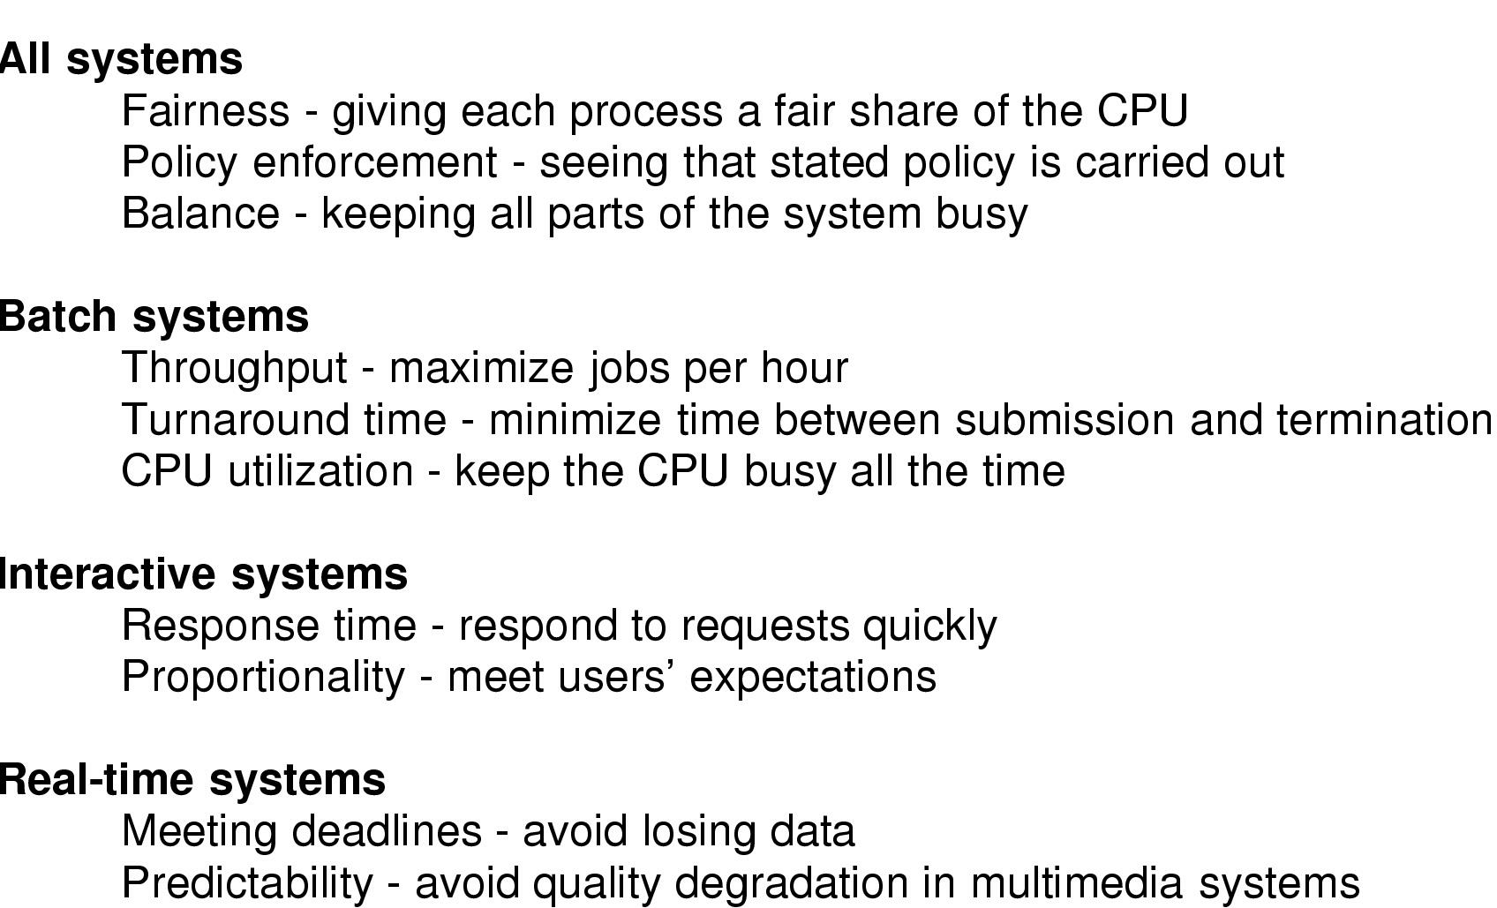
Introduction to Scheduling
Scheduling Algorithm Goals

Slide 12
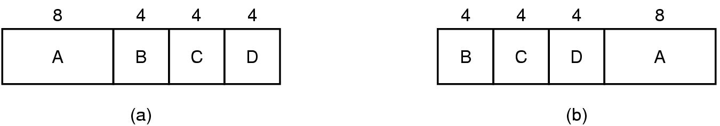
Scheduling in Batch Systems
(a) An example of longest job first scheduling
(b) An example of shortest job first scheduling

Slide 13
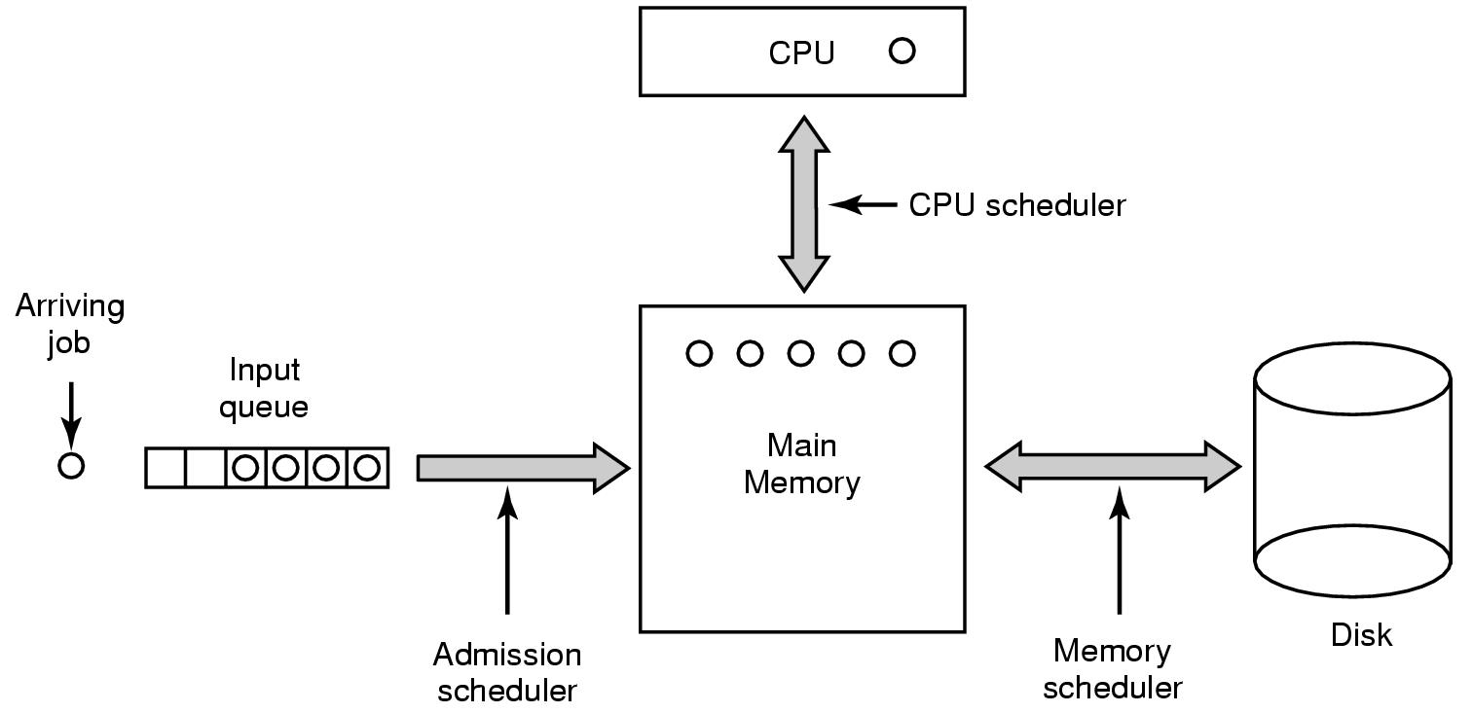
Scheduling in Batch Systems
Three level scheduling

Slide 14
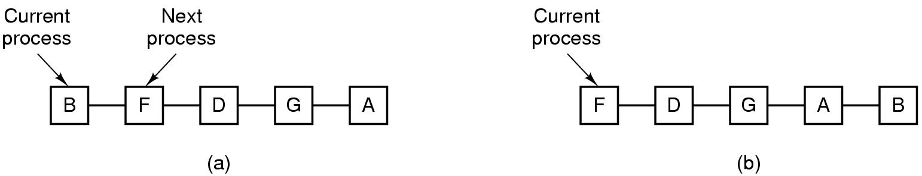
Scheduling in Interactive Systems
Round Robin Scheduling
  list of runnable processes
  list of runnable processes after B uses up its quantum

Slide 15
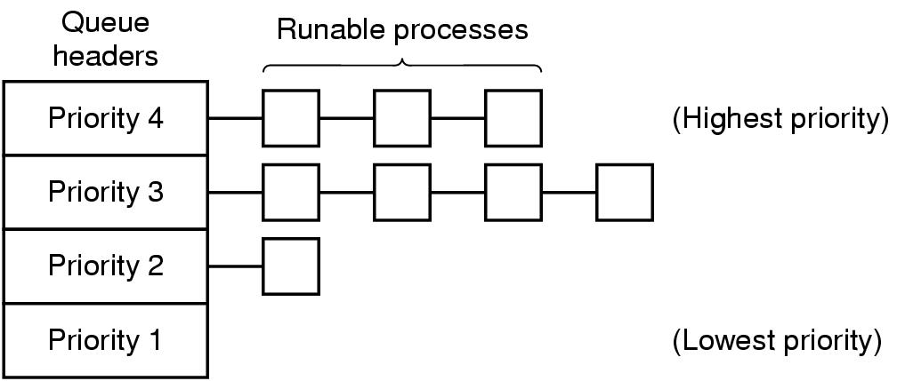
Scheduling in Interactive Systems
A scheduling algorithm with four priority classes

Slide 16
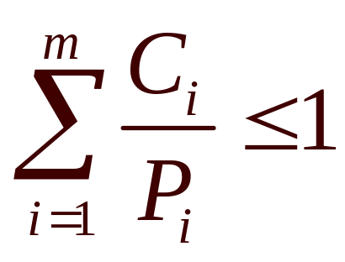
Scheduling in Real-Time Systems
Schedulable real-time system
Given
  m periodic events
  event i occurs within period P_{i} and requires C_{i} seconds
Then the load can only be handled if

Slide 17
Scheduling Algorithms
First-in-First-out (FIFO)
Processes are allocated the processor according to their arrival time on the READY state.
Round Robin
The top process in the READY state queue is allocated the processor for a unit of time. The process is sent back to the READY state queue provided it does not BLOCK itself during that time unit.
Highest Priority First
This technique allocates the processor to the process with the highest priority in the READY state queue. The technique can be handled either as preemptive or non-preemptive.

Slide 18
Shortest Job First
In this technique, the queue of processes in the READY state is ordered according to the running time required by each process. A process with the smallest estimated run-time in the READY state queue is allocated the processor. It is useful in timesharing.
Shortest Remaining Time
A job with smallest estimated run-time to completion including new arrivals in the READY state queue is assigned the processor. The scheme has a higher overhead than the Shortest Job First. It must keep track of the elapse service time of the running job.
Highest Response Ratio Next
This scheme correct the weaknesses in the Shortest Job First, particularly the bias against longer jobs and the excessive favouritism towards short new jobs as in the Shortest Remaining Time.

Slide 19
The priority of each job is a function of the job’s service time and the amount of time the job has been waiting for service.
time waiting + service time
Priority = ------------------------------------
service time

Slide 20
Policy versus Mechanism
Separate what is allowed to be done with how it is done
  a process knows which of its children threads are important and need priority
Scheduling algorithm parameterized
  mechanism in the kernel
Parameters filled in by user processes
  policy set by user process

Slide 21
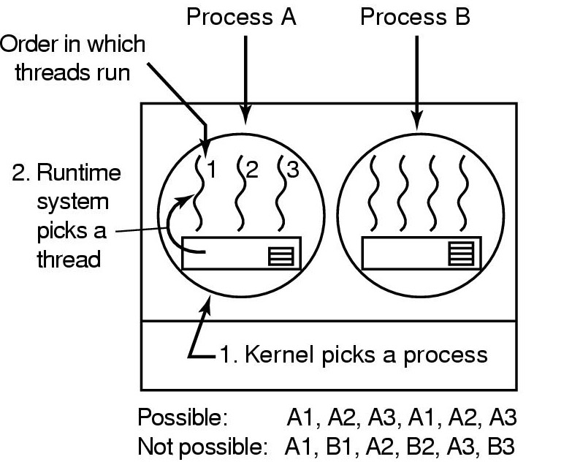
Thread Scheduling (1)
Possible scheduling of user-level threads
50-msec process quantum
threads run 5 msec/CPU burst

Slide 22
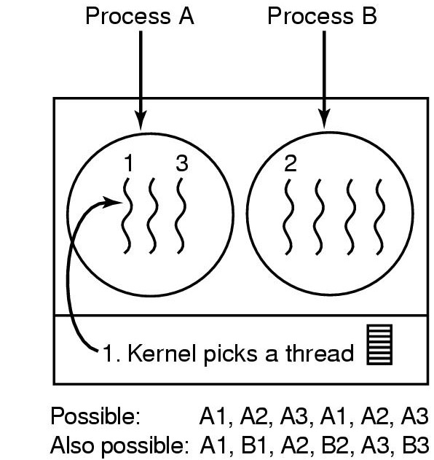
Thread Scheduling (2)
Possible scheduling of kernel-level threads
50-msec process quantum
threads run 5 msec/CPU burst

